Slide 1



Crawford Long Middle School
Annual Title 1 Meeting
Reunión Anual Título 1
Tuesday, October 25, 2022
5pm
School Auditorium
Family Engagement Committee

Slide 2

Welcome! We are happy you are here!
¡Bienvenido! ¡Estamos felices de que estés aquí!

Slide 3

AGENDA
Staff Introductions
  Ms. Hill, Principal
  Ms. Mayfield, School Business Manager
  Ms. Featherstone, Family Engagement Specialist
What You Need to Know About Title I?
  What Is Title I?
  What is the Schoolwide Improvement Plan?
  What are our goals?
  What curriculum does our school use?
Parent and Family Engagement
  Communicating and Partnering with Families
  What is the School-Parent Compact?
  What is the School Parent and Family Engagement Plan?
  What is the District Parent and Family Engagement Statement?
  What opportunities and events will the school offer parents?
Closing
Presentaciones del personal
  Sra. Hill, Directora
  Sra. Mayfield, gerente comercial de la escuela
  Sra. Featherstone, especialista en participación familiar
¿Qué necesita saber sobre el Título I?
  ¿Qué es el Título I?
  ¿Qué es el Plan de Mejoramiento Escolar?
  ¿Cuáles son nuestros objetivos?
  ¿Qué plan de estudios utiliza nuestra escuela?
Participación de los padres y la familia
  Comunicación y asociación con las familias
  ¿Qué es el Pacto Escuela-Padres?
  ¿Qué es el Plan Escolar de Participación de Padres y Familias?
  ¿Qué es la Declaración de participación de padres y familias del distrito?
  ¿Qué oportunidades y eventos ofrecerá la escuela a los padres?
Clausura

Slide 4

What is Title I ?
It’s the largest federal aid program for public schools in the United States.
Title I is designed to support State and local school reform efforts tied to the challenging State academic standards to improving teaching and learning for students.
Title I programs must be based on effective means of improving student achievement and include strategies to support parent and family engagement.
Notes:
This is where you will share a definition of Title I.

Slide 5

Being a Title I school means receiving federal funding (Title I dollars) to supplement the school’s existing programs.
Identifying students experiencing academic difficulties and providing timely assistance to help these students meet the State’s challenging content standards.
Purchasing supplemental staff/programs/materials/supplies
Conducting parental Involvement meetings/trainings/activities
Recruiting/Hiring/Retaining Highly Qualified Teachers
Being a Title I school also means parental involvement and parents’ rights.

Slide 6

Discussion of Budget Summary

Slide 7
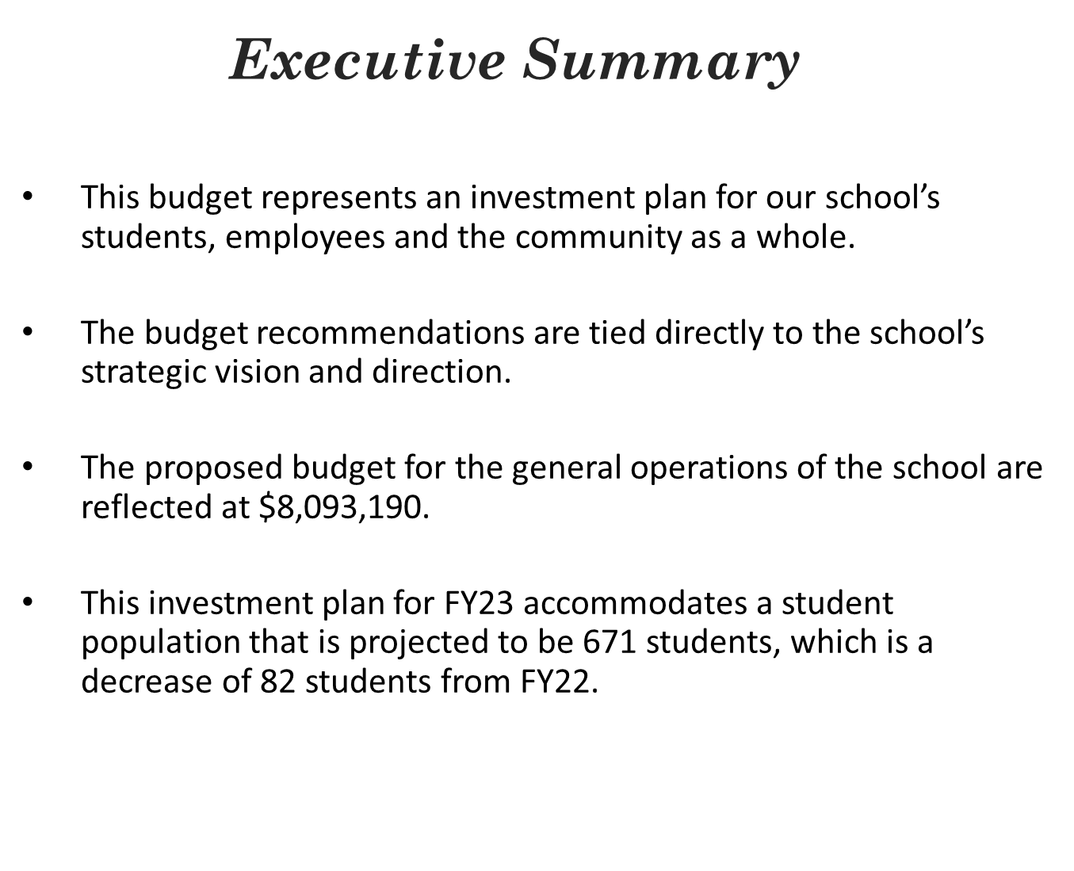

Slide 8
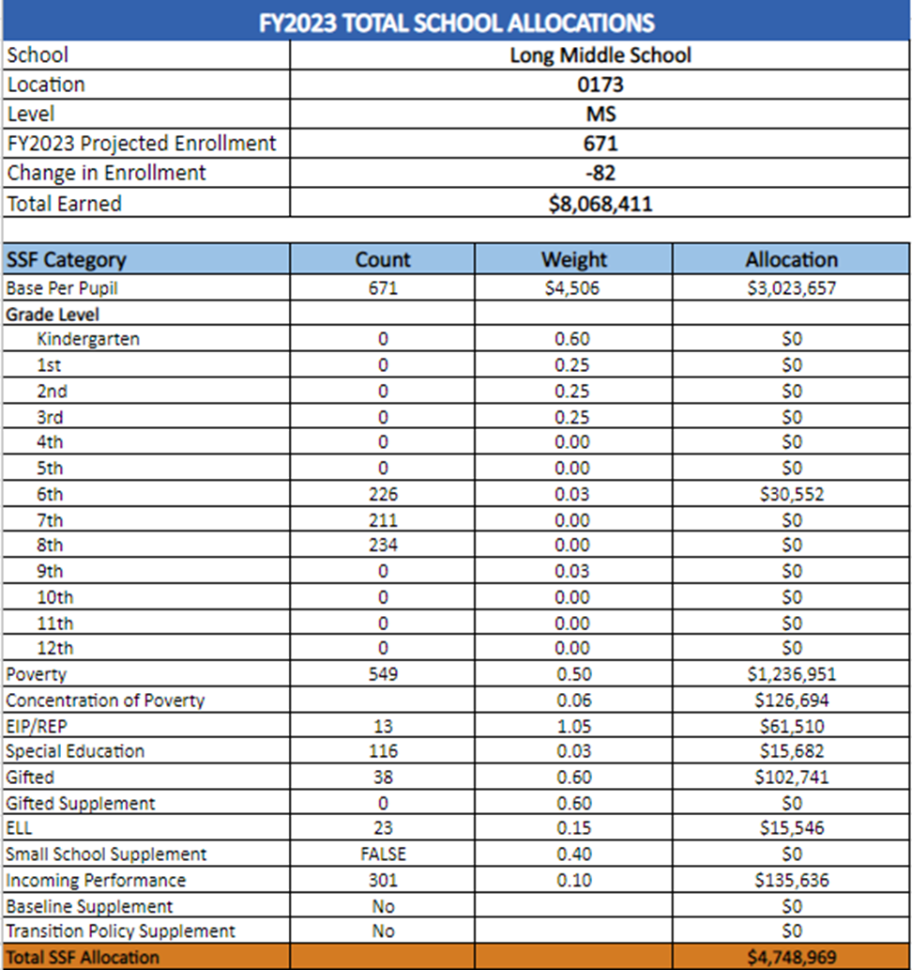
School Budget

Slide 9
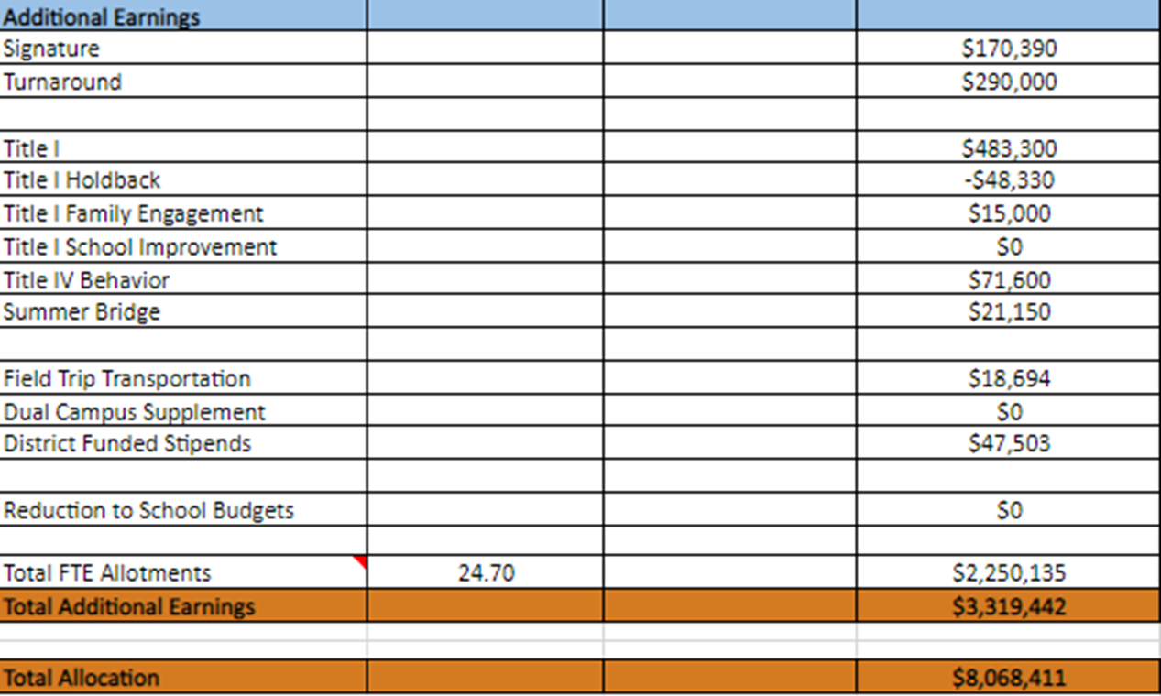
School Budget

Slide 10
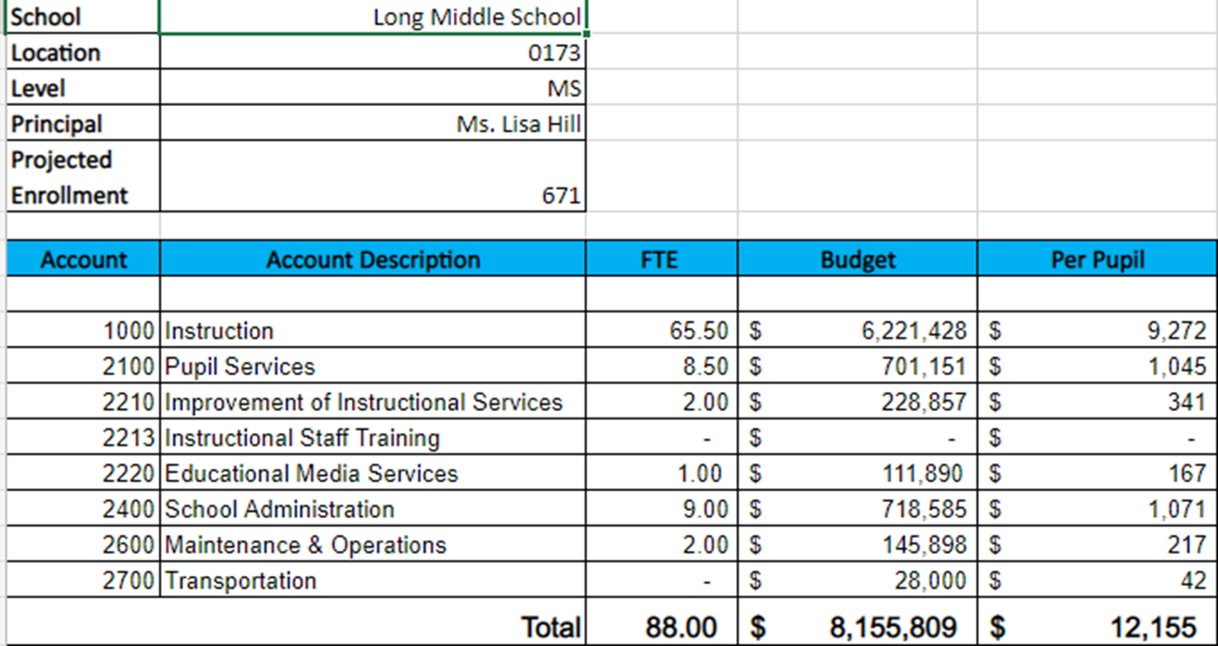
School Budget

Slide 11
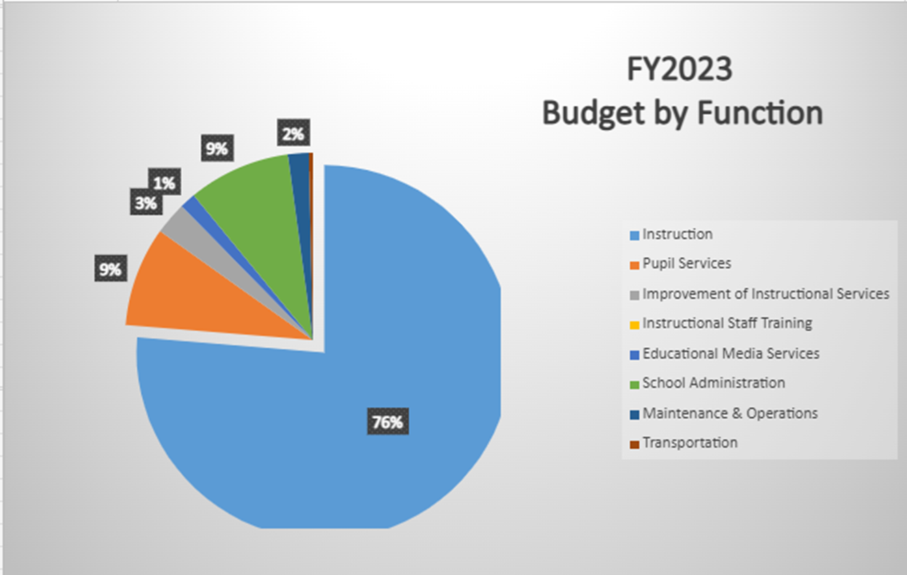
School Budget

Slide 12
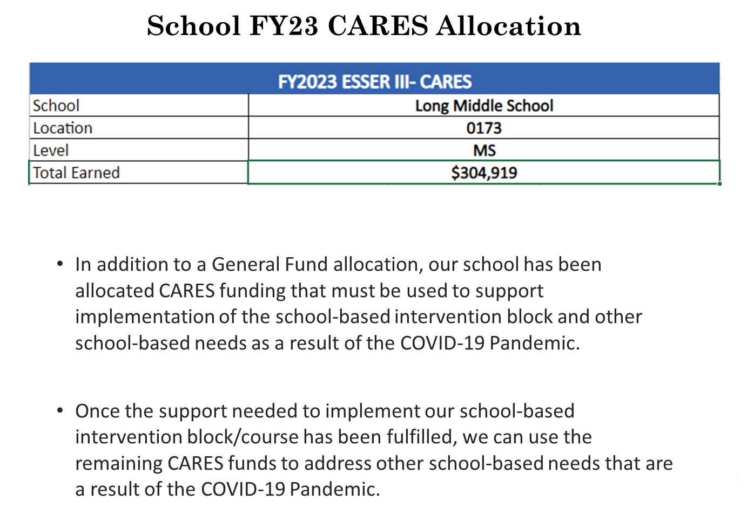

Slide 13
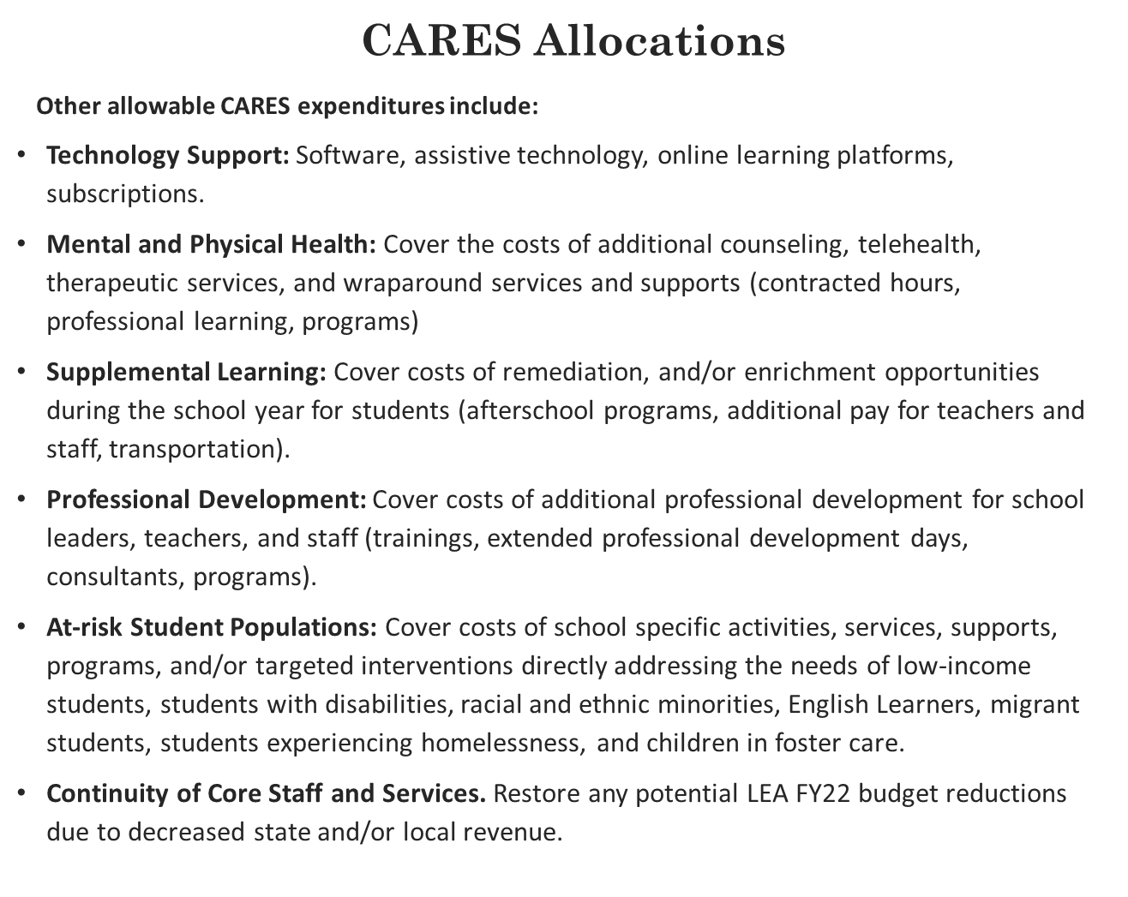

Slide 14

WHAT IS PARENT AND FAMILY ENGAGEMENT?
Parent and Family Engagement is an ongoing process that increases active participation, communication, and collaboration between parents, schools, and communities with the goal of educating the whole child to ensure student achievement and success.

Slide 15
School Parent and Family Engagement Plan
The plan establishes the school’s expectations for parent and family engagement and describes how our school will implement a number of specific parent and family engagement activities, and it is incorporated into the school’s plan submitted to the local educational agency (LEA).
School Parent Compact
School parent compact outlines how the parents, the entire school staff, and the students will share the responsibility for improved student academic achievement as well as describes how the school and parents will build and develop a partnership that will help children achieve the state’s high standards.
District Parent And Family Engagement Statement
The statement establishes Atlanta public school’s expectations and objectives for meaningful parent and family engagement and describes how the district will implement a number of specific parent and family engagement activities, and it is incorporated into the lea’s plan submitted to the Georgia Department of Education.
SCHOOL COMPACTS AND PLANS WILL BE DISTRIBUTED ONLINE AND THROUGHOUT THE SCHOOL YEAR.

Slide 16

UPCOMING PARENT AND FAMILY ENGAGEMENT EVENTS!
(List school events here.)
Parents and families we look forward to you joining us for these opportunities and events. If you are interested in getting involved, please reach out to your child’s teacher or the front office.

Slide 17

THANK YOU FOR ATTENDING!
PLEASE COMPLETE OUR SURVEY.

